Slide 1

EasyTravel
G Sai Vamsi 190330079
P Karthik Reddy 190330184
Svsl Anand Kathyay 190330228

Slide 2
ABSTRACT
Car and bus travel agencies need an effective management platform for handling their respective transportation services. The existing system relies on manual data recording for management which is very tedious and time consuming, involving a lot of manpower and paper work. So, the current system need to be computerized, and if possible web-based.
The main idea of this project is to offer the best of car services to the clients in need. It has a fleet of cars ranging from normal budget cars to expensive luxury cars. The best thing about a web-based system such as this is that it offers online car hire for corporate houses. This makes the overall car service work easily accessible and reliable.

Slide 3
OBJECTIVE
The main objective of our project is to provide an option for the customer to choose his/her favourite car to travel instead of pouring so much money on taxis or to avoid overcrowded metro trains when he is out of town/country.
Our EasyTravel website allows the customer to book the rental online and could provide valuable feedback for improvement in services.
It has an easy to understand interface and as this system works online it allows anyone to book or rent a vehicle in a city without any time restriction

Slide 4
HARDWARE REQUIREMENT
 | Client side:
 | RAM |  | 2-4 GB
 | Hard disk |  | 10 GB
 | Processor |  | 2.0 GHz
Server Side:
 | RAM |  | 2-4 GB
 | Hard disk |  | 20 GB
 | Processor |  | 2.0 GHz

Slide 5
SOFTWARE REQUIREMENT
 | Client Side:
 | Web Browser | Web Browser |  | Google, Mozilla Firefox etc.
Server side:
 |  | Web Server |  | Tomcat server
 |  | Database Server |  | MySql
 |  | Other Softwares |  | Eclipse, Mysql-Workbench , Java

Slide 6
FUNCTIONAL SPECIFICATIONS:
User can view information of available car list, book the car easily, get the car on rent and also give feedback.
Admin can view the list of cars, view all the members and see their bookings also he can view feedback of all customers.

Slide 7
MODULES
Admin: The admin can able to view all the user and their bookings. Also he
could see all the available cars. He could easily view feedbacks of customers and solve the query.
Cars: This helps user to view all the list of cars.
Booking: The user can select the available cars and book then for a period of time.
My Bookings: This helps user to view his bookings.
Sign In/ Sign Up: This helps user to sign up or sign in to our website
Logout: This helps user to logout from his session.

Slide 8
MODULE SPECIFICATION
View Available Cars: It is a system design specially for car rental. The user can view
Available cars and user can book for that car.
Booking Car : The user can view Available cars and book for a car. If the car is
already booked the user must book another car.
Easily Get the Car on rent : The Customer can easily get the car whenever they need
to on the rent with in a determined period.
Give Feedback : The customer will give the feedback to the admin.
Manage Rent: The Admin can able to see all the available car see all the customers
and their bookings.
View Feedback: The admin easily view the feedbacks and solve the query.

Slide 9
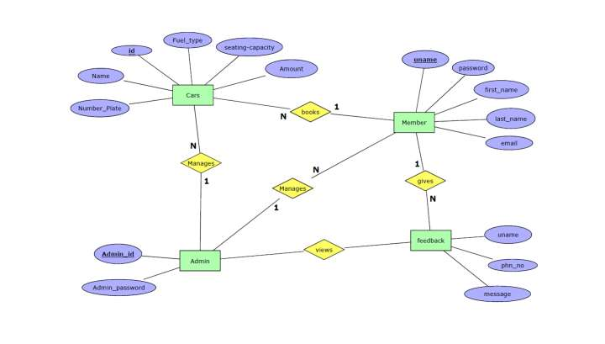
ER DIAGRAM

Slide 10
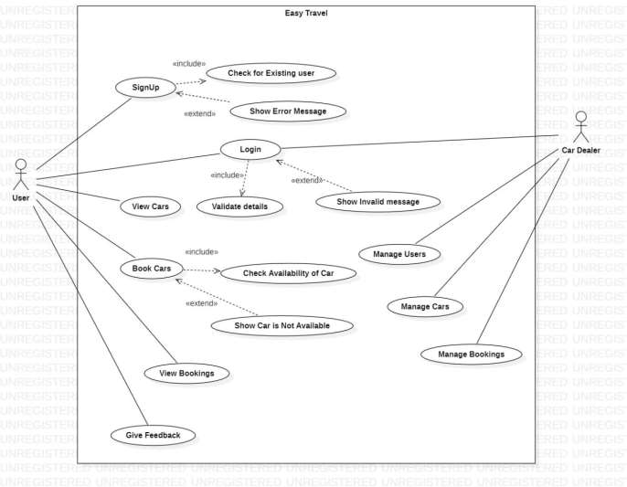
USE CASE DIAGRAM

Slide 11
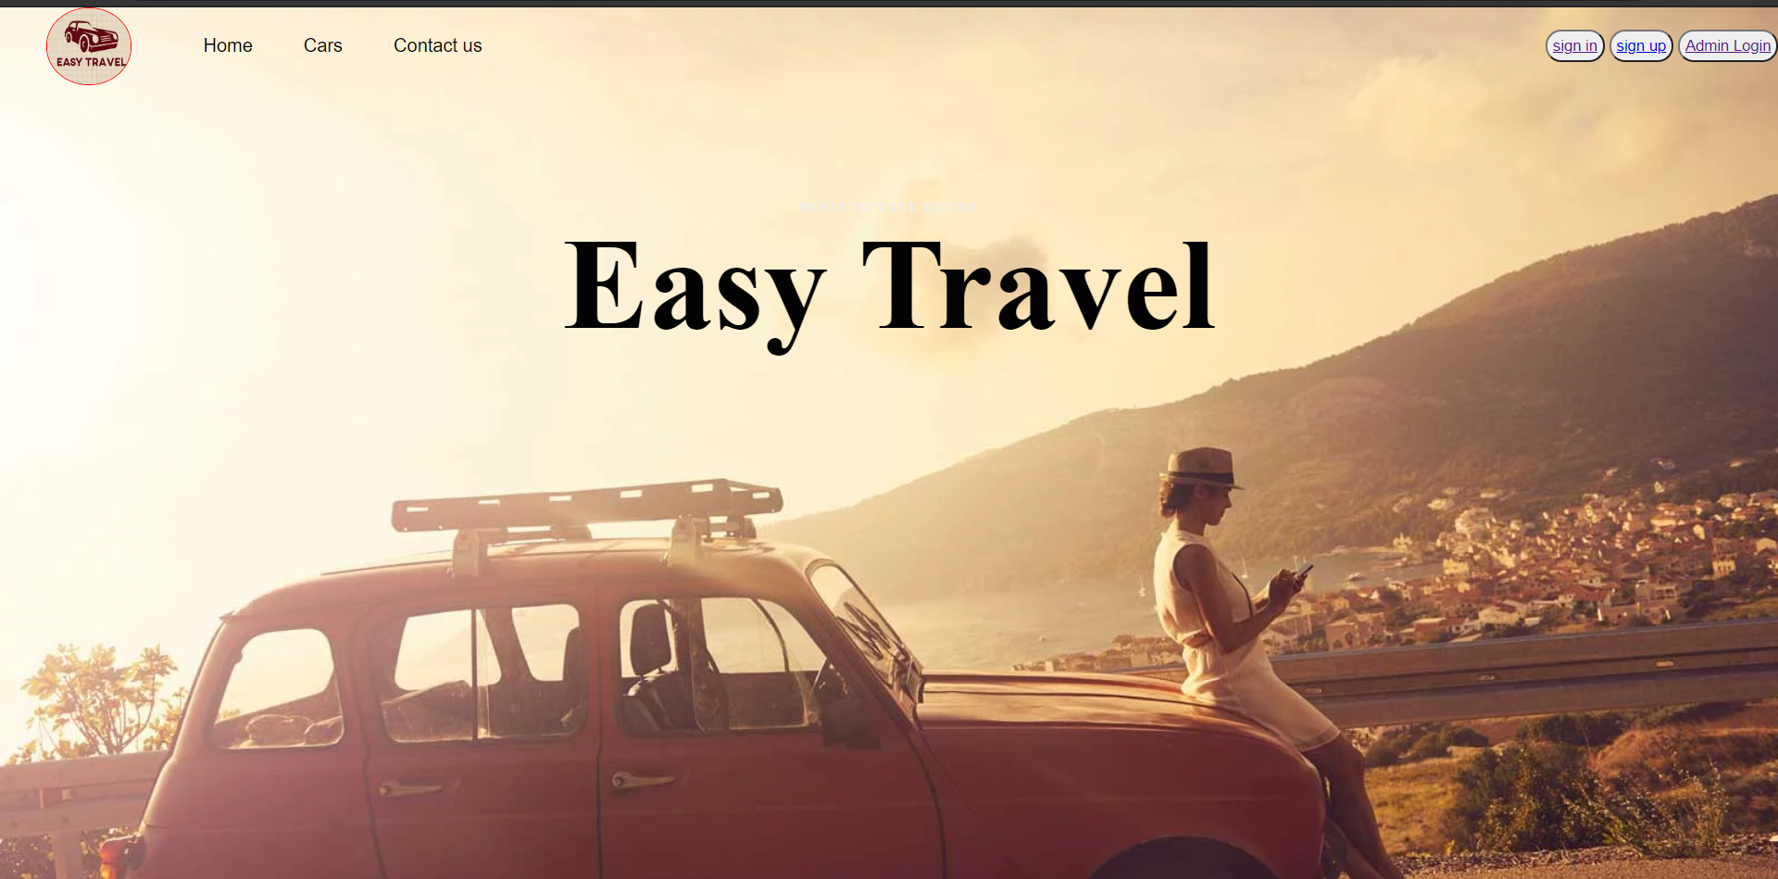
OUTPUT SCREENS

Slide 12
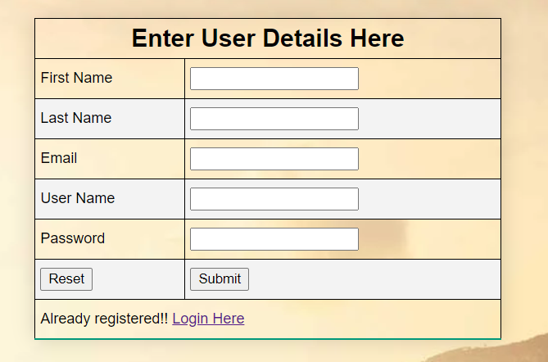
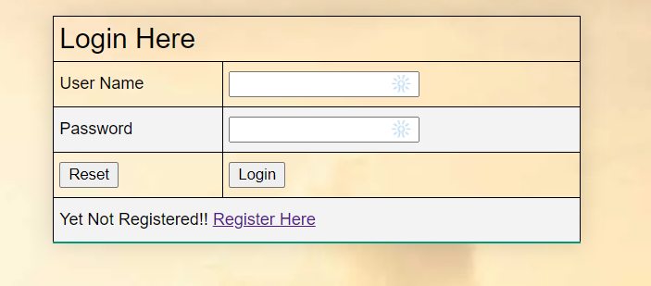
OUTPUT SCREENS

Slide 13
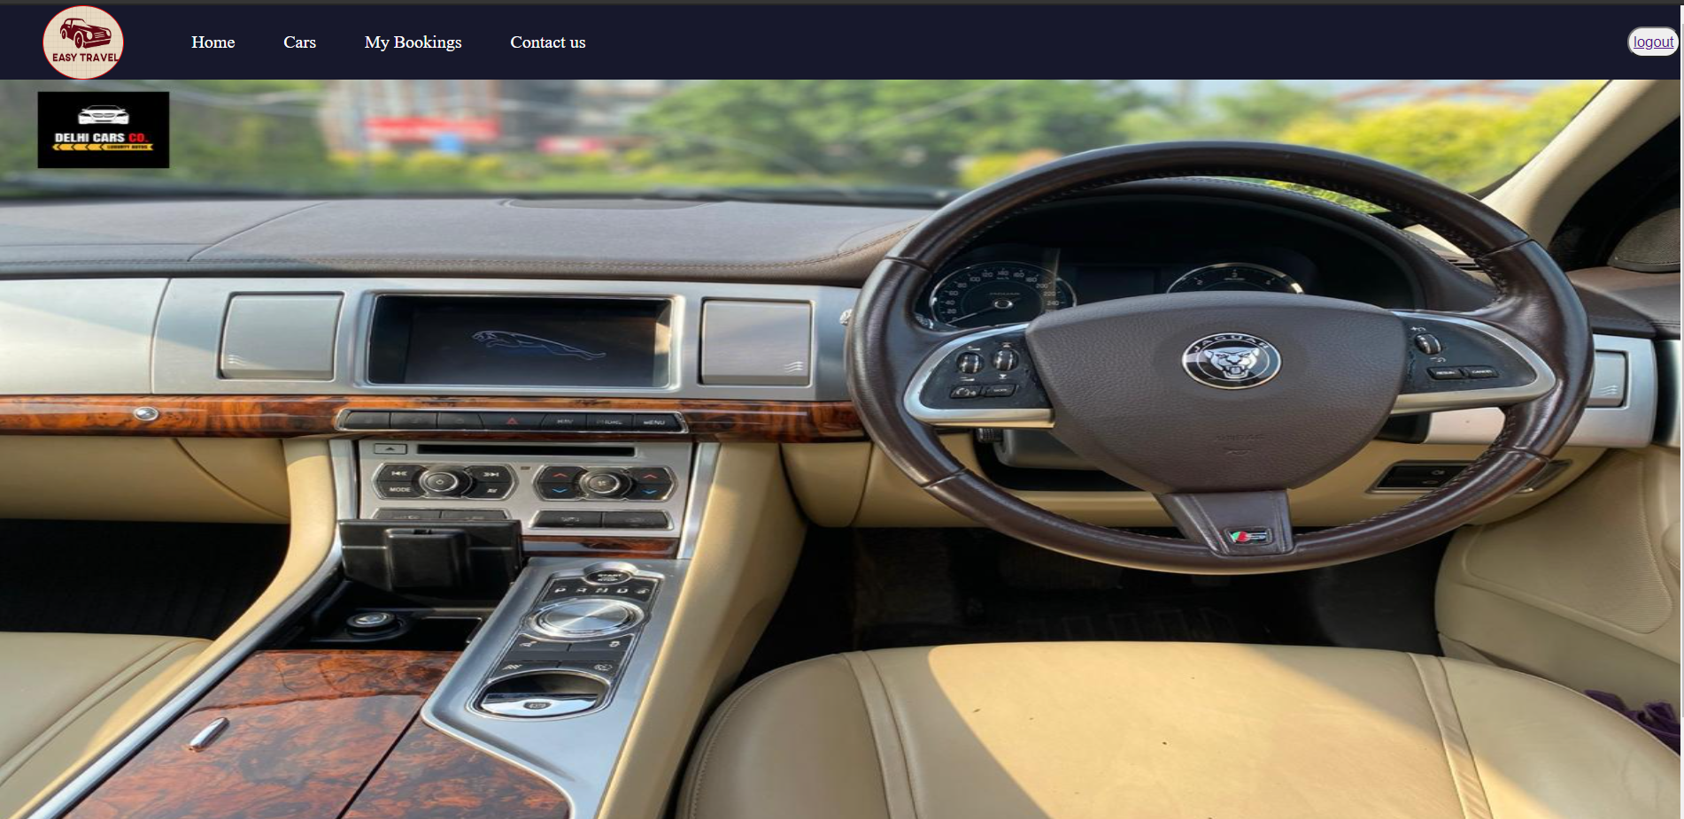
OUTPUT SCREENS

Slide 14
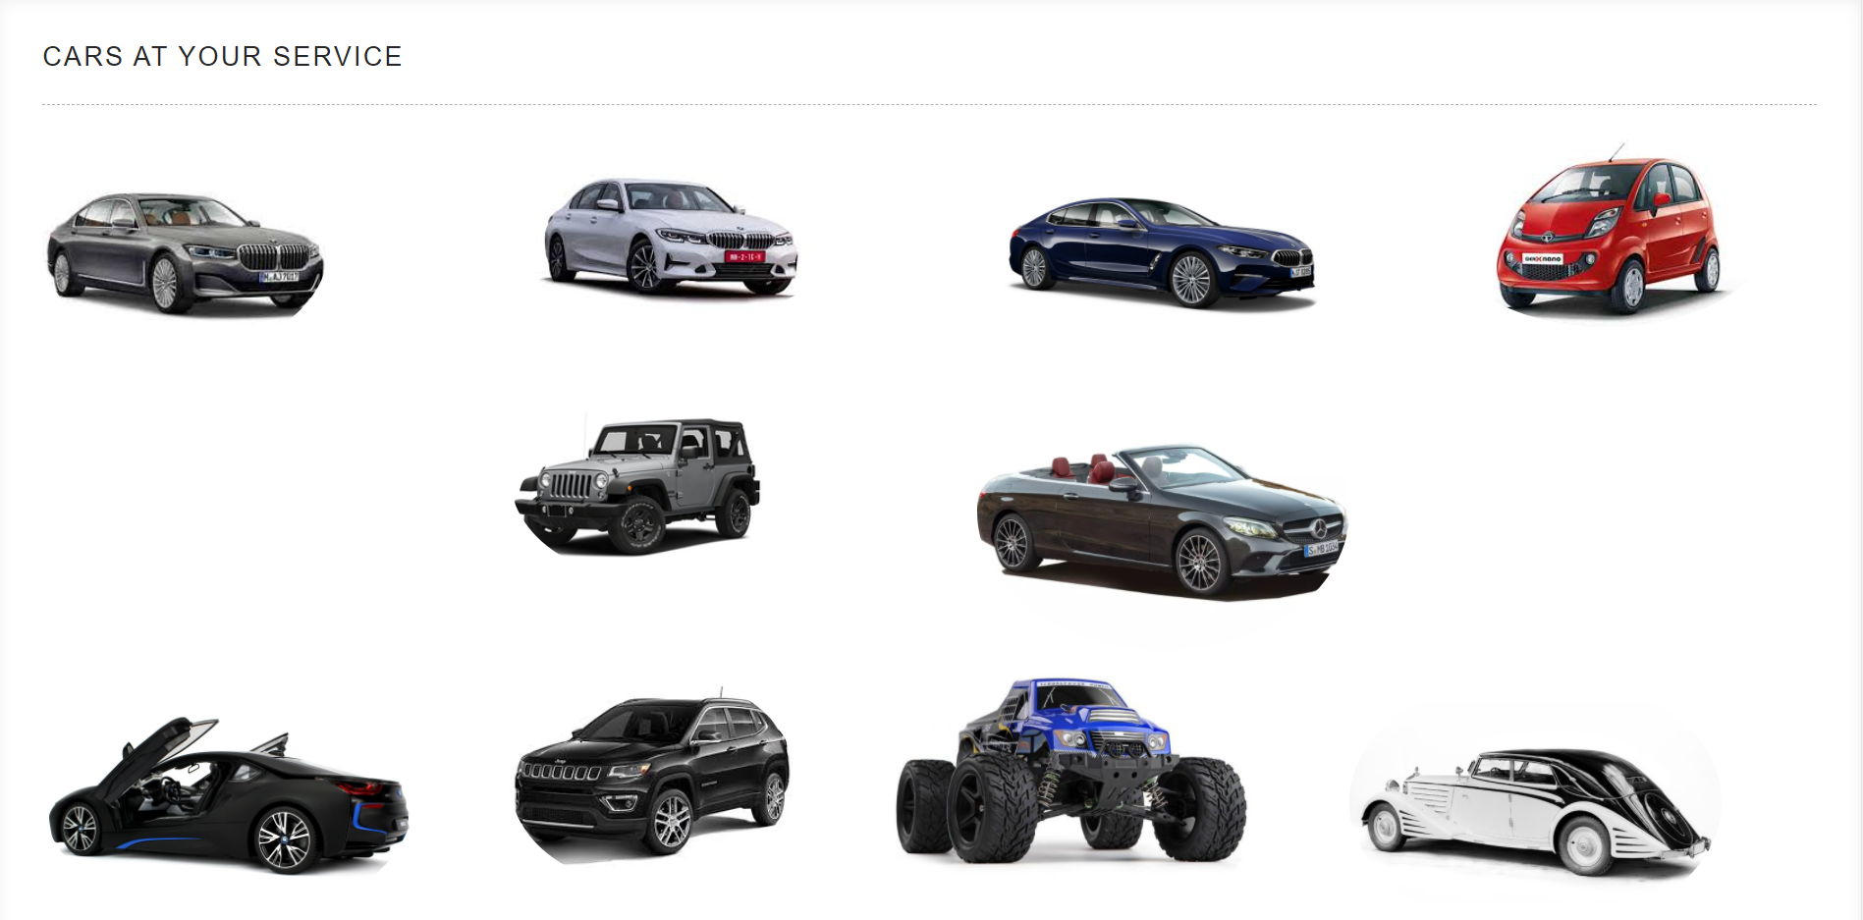
OUTPUT SCREENS

Slide 15
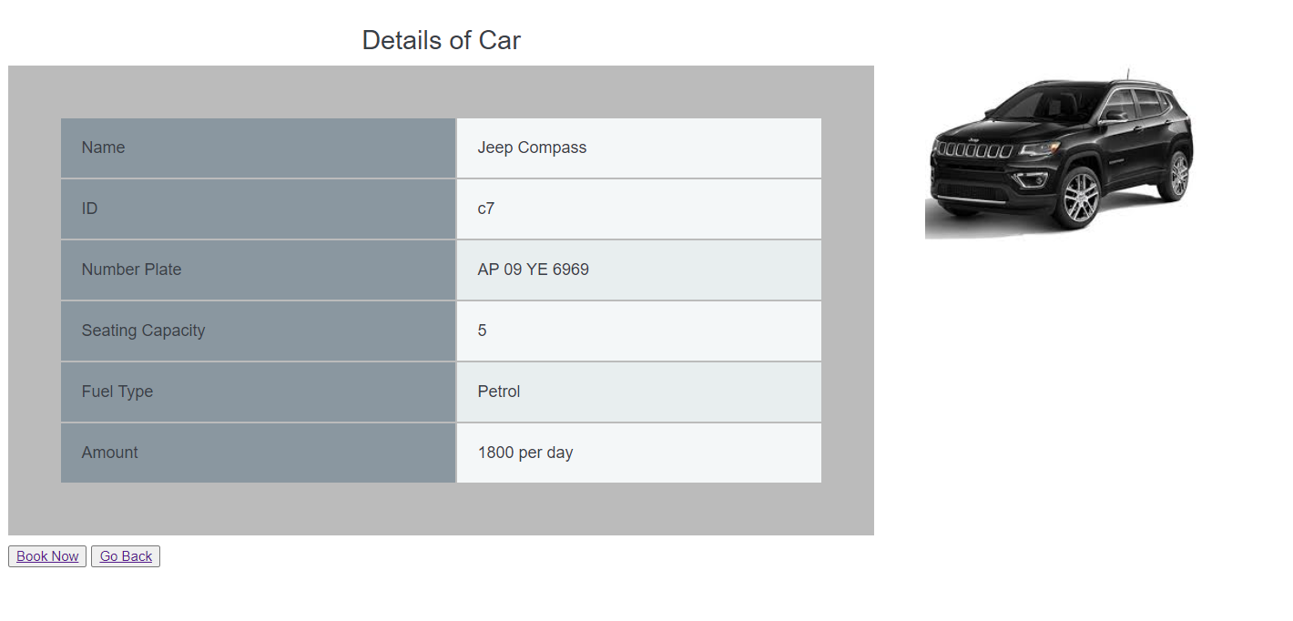
OUTPUT SCREENS

Slide 16
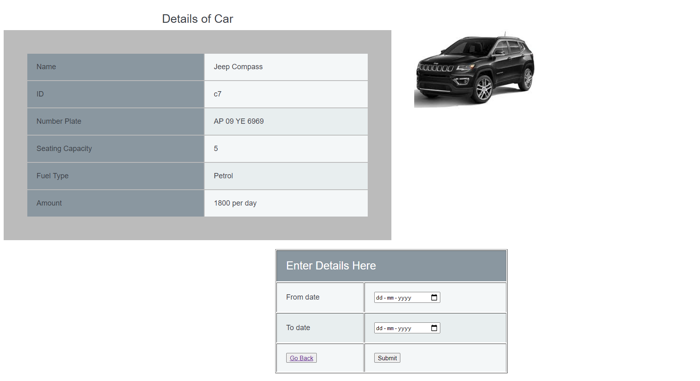
OUTPUT SCREENS

Slide 17
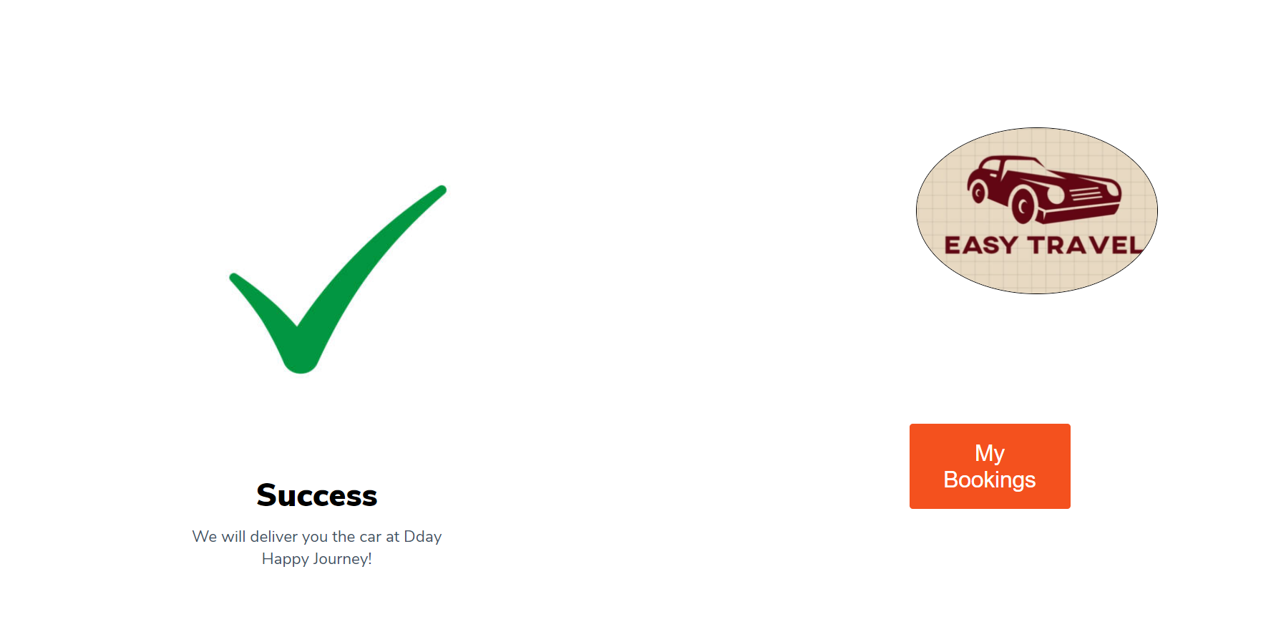
OUTPUT SCREENS

Slide 18
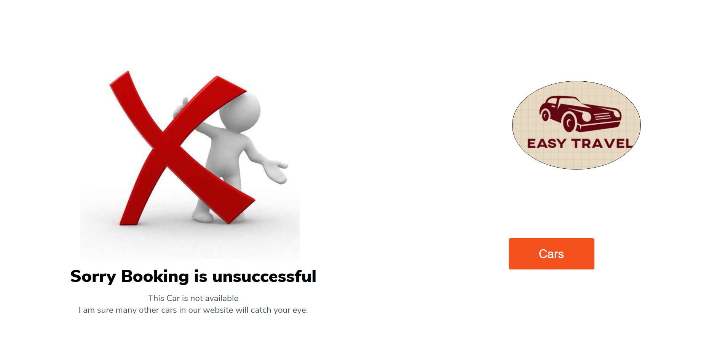
OUTPUT SCREENS

Slide 19
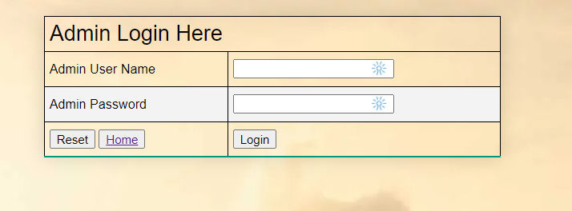
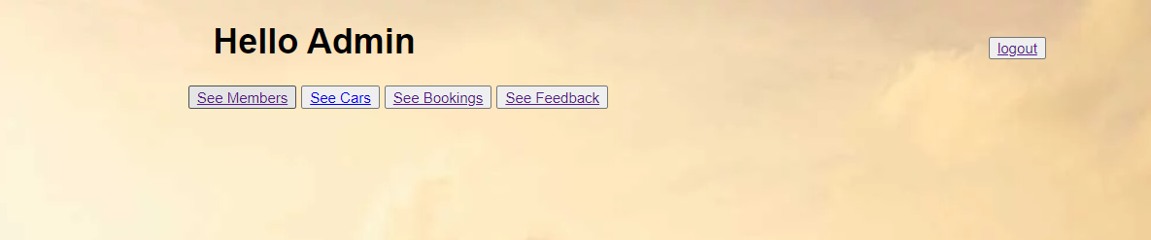
OUTPUT SCREENS

Slide 20
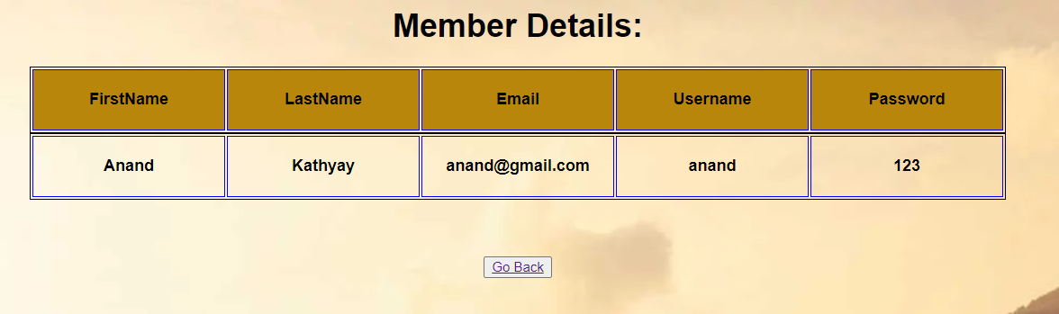
OUTPUT SCREENS

Slide 21
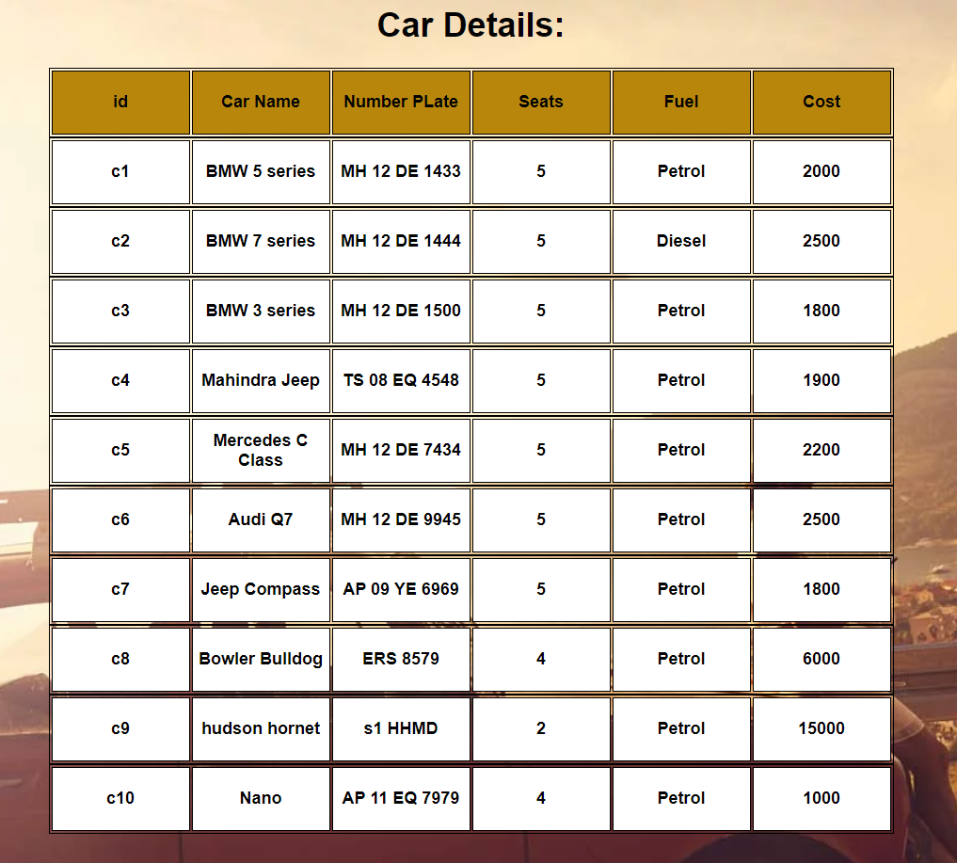
OUTPUT SCREENS

Slide 22
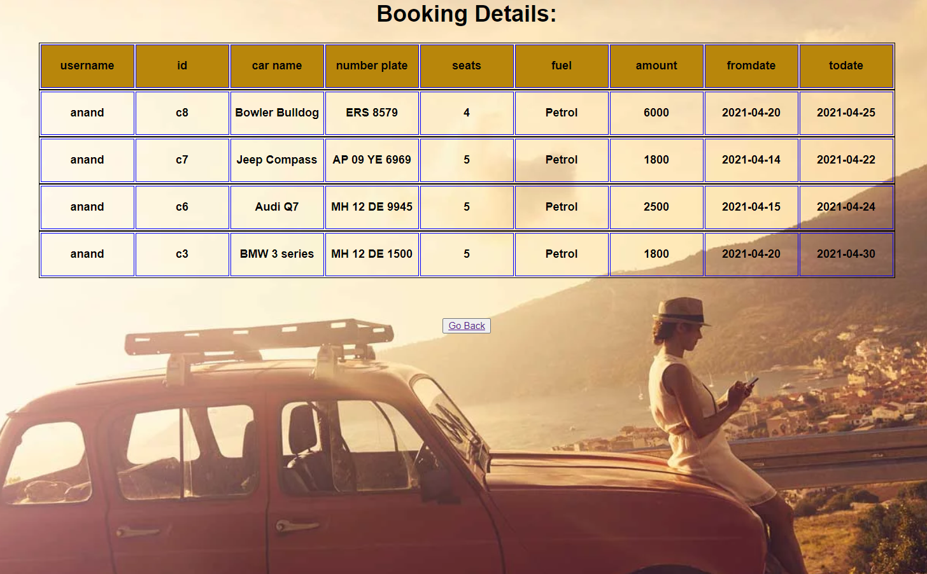
OUTPUT SCREENS

Slide 23
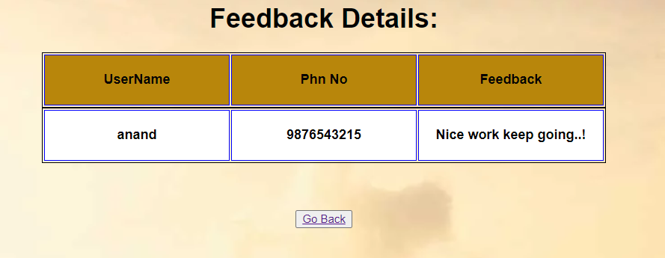
OUTPUT SCREENS

Slide 24
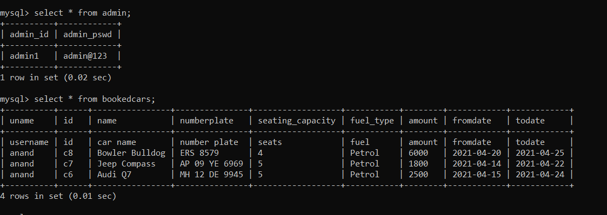
DATA DICTIONARY

Slide 25
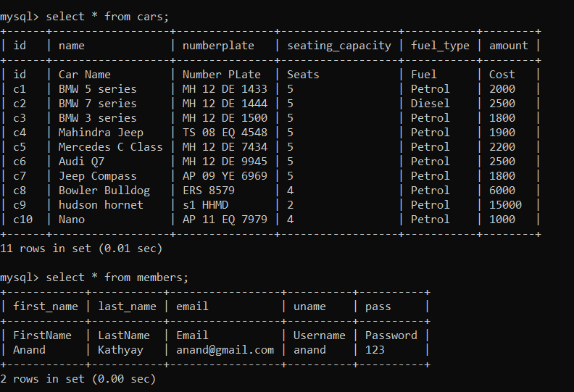
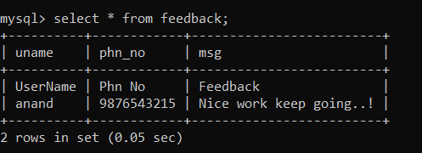
DATA DICTIONARY

Slide 26
POST IMPLEMENTATION
The website application is self maintained.
There is no need provide post implementation support.
The admin can access add, edit, delete process.

Slide 27
CONCLUSION
The web based car rental system has offered an advantage to both customers as well as Car Rental company to efficiently and effectively manage the business and Satisies customers need at the click of a button.
And considering present situations, online mode is very effective, comfy and also safe.
The proposed project is very flexible, so new features and modules can be added in the future as per user requirements.

Slide 28


